Slide 1
Using Babylon.js for beginner
Introduction to WebGL 3D with HTML5 and Babylon.js

Slide 2


WHO ARE WE?
Geeks, web developers, 3D addicts
DAVID ROUSSET
DAVID CATUHE
TECHNICAL EVANGELIST
PRINCIPAL PROGRAM MANAGER
Twitter: @davrous
http://blogs.msdn.com/davrous
Twitter: @deltakosh
http://blogs.msdn.com/eternalcoding
Do not try to tune your speakers, the weird sound is due to French accent…

Slide 3
TEASER – WHAT YOU’LL LEARN
DEMO
Notes:
Scenes with all the beautiful spheres
3D Maze with the gamepad camera

Slide 4
AGENDA
1
Basic scene components: meshes, lights and cameras
2
Materials
3
Working with inputs
4
Using the Playground

Slide 5
Section One
Basic scene components: meshes, lights and cameras

Slide 6
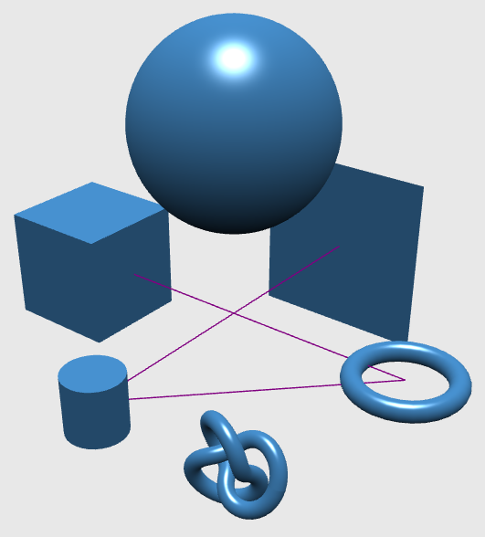
BABYLON.JS Meshes main primitives
Sphere
Plane
Box
Torus
Cylinder
Lines
TorusKnot

Slide 7

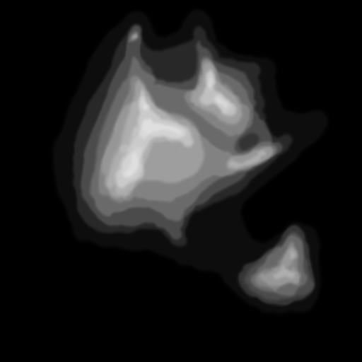
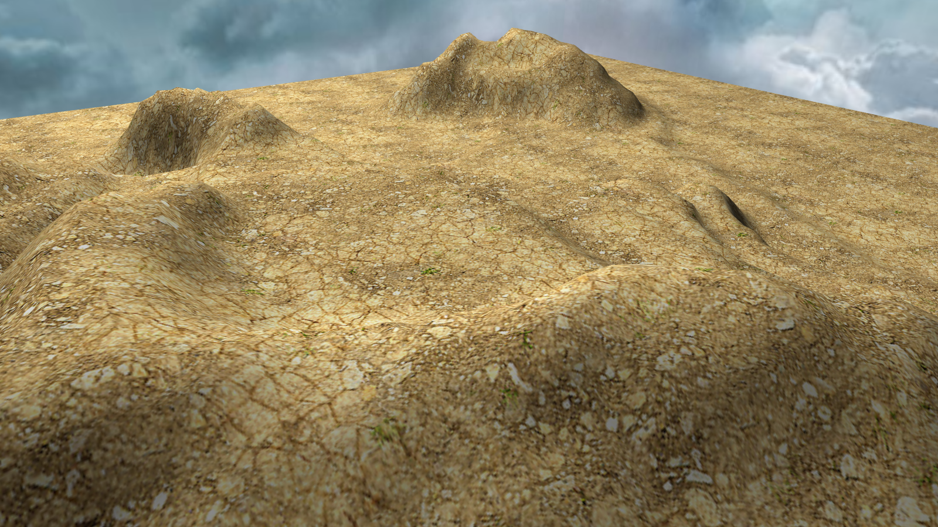
Ground & Ground From HeightMap
+
=

Slide 8
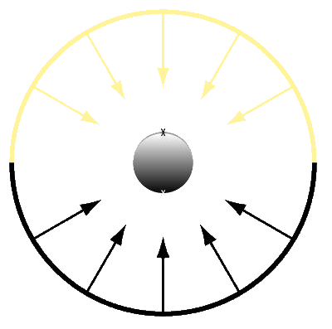
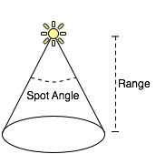
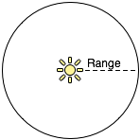
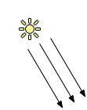
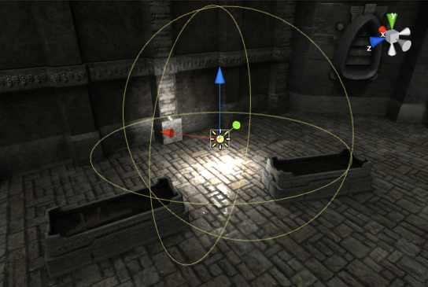
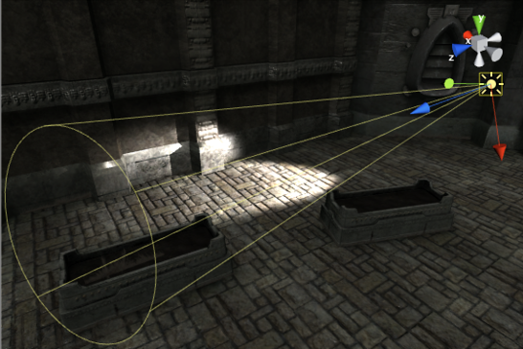
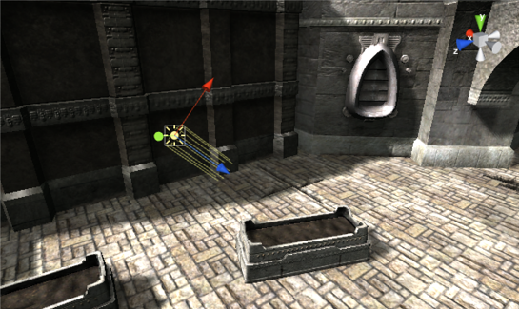
BABYLON.JS Lights
HemisphericLight
PointLight
SpotLight
DirectionalLight

Slide 9
USING MESHES, CAMERAS & LIGHTS
DEMO

Slide 10
Section Two
Materials

Slide 11
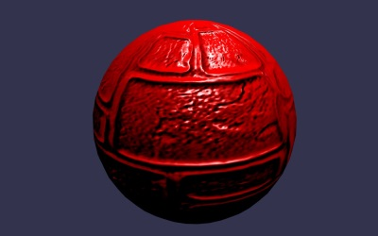
Uber shader - StandardMaterial
StandardMaterial hides shaders complexity
It supports:
Diffuse
Specular
Emissive
Bump
Opacity
Ambient
Reflection
Alpha

Slide 12
DISCOVERING THE STANDARDMATERIAL
DEMO

Slide 13
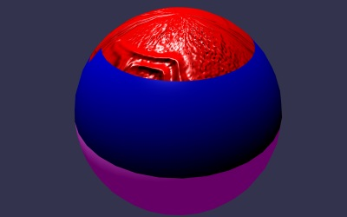
MultiMaterial
Container allowing you to apply many materials to a single object
Segment a mesh into sub-meshes

Slide 14
USING MULTIMATERIALS
DEMO

Slide 15
Dynamic texture
What about using canvas 2D API to generate texture content?
This is the magic done by BABYLON.DynamicTexture
All 2D API are available (Text, Arc, etc..)
Warning: each update will trigger a copy to GPU memory

Slide 16
USING DYNAMIC TEXTURE
DEMO

Slide 17
Section Three
Working with inputs

Slide 18






PLAYING WITH INPUT
Device Orientation
Virtual Joysticks
Touch
Anaglyph
Oculus
Gamepad
Using pointer events, this camera generates two joysticks on top of the scene
Use this camera with Red/Green glasses
Use your gamepad to control your camera
Camera based on Device Orientation API
Control camera orientation with Oculus Rift device
Camera based on pointer events

Slide 19
CAMERAS & INPUTS
DEMO

Slide 20
Section Four
Using the Playground

Slide 21
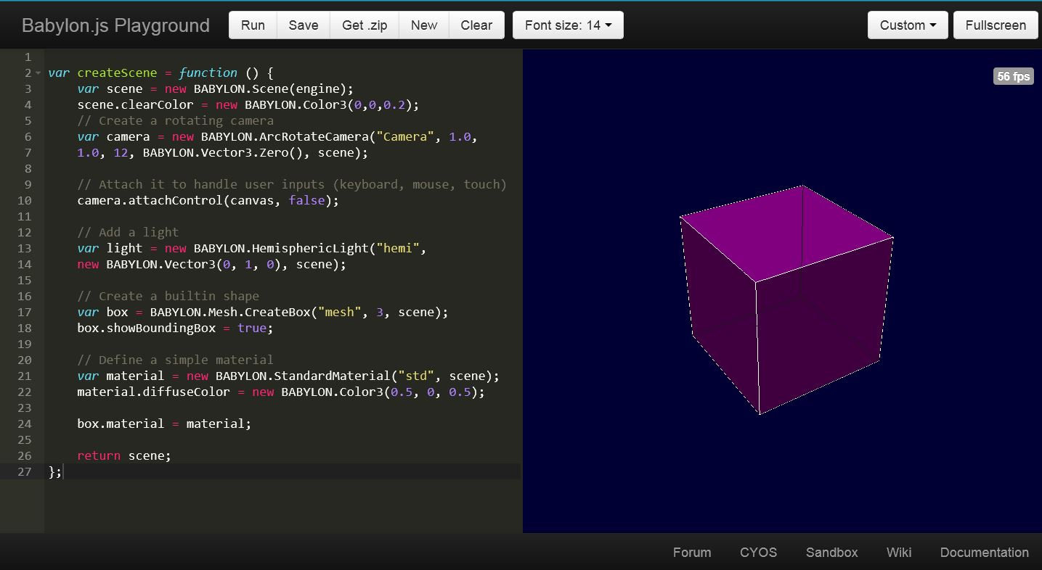
Learning Babylon.js using the playground
Get sample code
Try and experiment
Share with friends
Learn by reading examples

Slide 22
USING THE PLAYGROUND
DEMO

Slide 23
Going further with some online tutorials
Creating a Basic Scene
Create Basic Elements (shapes/meshes)
Position, Rotation and Scaling
Materials
Babylon.JS Cameras
Lights
Cameras collisions
Height map
Creating a 3D WebGL Procedural QR-Code Maze with Physics

